Slide 1
Managing Project and Teams
Lecture 8: Project Metrics and Performance Measurement in Teams

Slide 2
Retrospection
Risk assessment
Risk control
Ethical consideration in risk closure
Risk Management Culture
Notes:
Managing project scope, quality, and responsibility are critical components of project management, ensuring that projects are delivered successfully, meet stakeholder expectations, and achieve their intended outcomes.

Slide 3
If you cant measure it you can't manage

Slide 4
Key topics covered in this lecture

Slide 5
What we will cover in this lecture
By the end of the lesson, students should be able to:
Define performance metrics
Classify performance measurement
Implementing Key Performance Indicators (KPIs) for project success.
Balancing quantitative and qualitative measures.
Decide on metrics specific for a project.

Slide 6
Project Metrics
Performance measurement process involves determining and monitoring the project's performance based on the criteria established by the stakeholders.
A metric is a standard definition of any measurable quantity, and a performance metric is a standard definition of a measurable quantity that indicates some aspect of performance (Deru and Torcellini, 2005).
Similar terms used are performance indicator, performance index, and benchmarking.
Project teams measure quality using metrics and acceptance criteria based on requirements.
Performance measurement occurs at three level: corporate level, strategic level, operation level.

Slide 7
Performance measurement levels
Corporate Level- Long term goals, Finance, Environmental and Societal performance (Balancing People, Planet & Profit= Sustainability).
Strategic Level- Alignment with corporate level. Use strategic KPIs and resource allocation.
Operational Level- Use operational KPIs, Day to day operations
Notes:
Corporate social responsibility to

Slide 8
Characteristics of quality metrics
Performance metrics need certain characteristics to be valuable and practical. A performance metric should:
Be measurable (or able to be determined from other measurements).
Have a clear definition, including boundaries of the measurements.
Indicate progress toward a performance goal.
Answer specific questions about the performance.
Repeatable
Economical
Language independent

Slide 9
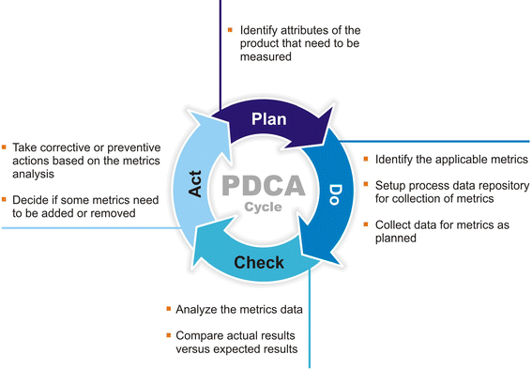
Metrics-based process improvement
The PDCA (Plan, Do, Check, Act) Cycle was made popular by Dr. W. Edwards Deming (1986).

Slide 10

Performance Metrics in Software Engineering

Slide 11
Classification of Software Metrics
Software Metric
Product Metrics | Used to evaluate the state of the product, tracing risks and undercover prospective problem areas. Examples-lines of code, code coverage, defect density, and code maintainability index
Process Metrics | These enhance the long-term process of the team or organization. Examples -effort variance, schedule variance, defect injection rate, and lead time
Project Metrics | Describes the characteristic and execution of a project. Examples Number of software developer, Staffing patterns over the life cycle of software, Cost and schedule, Productivity

Slide 12
Software performance measurement metrics
Response Time
Throughput
Resource Utilisation
Scalability
Error rate
Latency
Load Testing Metrics

Slide 13
Case Study: Discussion
A prominent bank, “CABS” is launching a mobile banking application to provide its customers with convenient access to banking services on their smartphones. The application allows users to check account balances, transfer funds, pay bills, and perform other banking transactions securely.
What are the metrics you use to measure the performance of the team/project?.

Slide 14
KEY PERFORMANCE MEASUREMENT MODELS
Balanced Scorecard (BSC)
Key Performance Indicators (KPIs)
Performance Prism
Benchmarking

Slide 15
Summary

Slide 16
Key takeaway points

Slide 17
Next Lesson
Stakeholder Analysis and Management

Slide 18
References
Deru, M. and Torcellini, P., 2005. Performance metrics research project-final report (No. NREL/TP-550-38700). National Renewable Energy Lab.(NREL), Golden, CO (United States).
Guide, P.M.B.O.K., (2017). A Guide to the Project Management Body of Knowledge (PMBOK® Guide), Project Management Institute.
Murray, A.P., 2016. The Complete Software Project Manager: Mastering Technology from Planning to Launch and Beyond. John Wiley & Sons.
Verzuh, E., 2015. The fast forward MBA in project management. John Wiley & Sons.
Ward, G.G., 2018. Effective project management: guidance and checklists for engineering and construction. John Wiley & Sons.

